Slide 1
Cyber Kill Chain
Use case: Feedback Sharing System

Slide 2
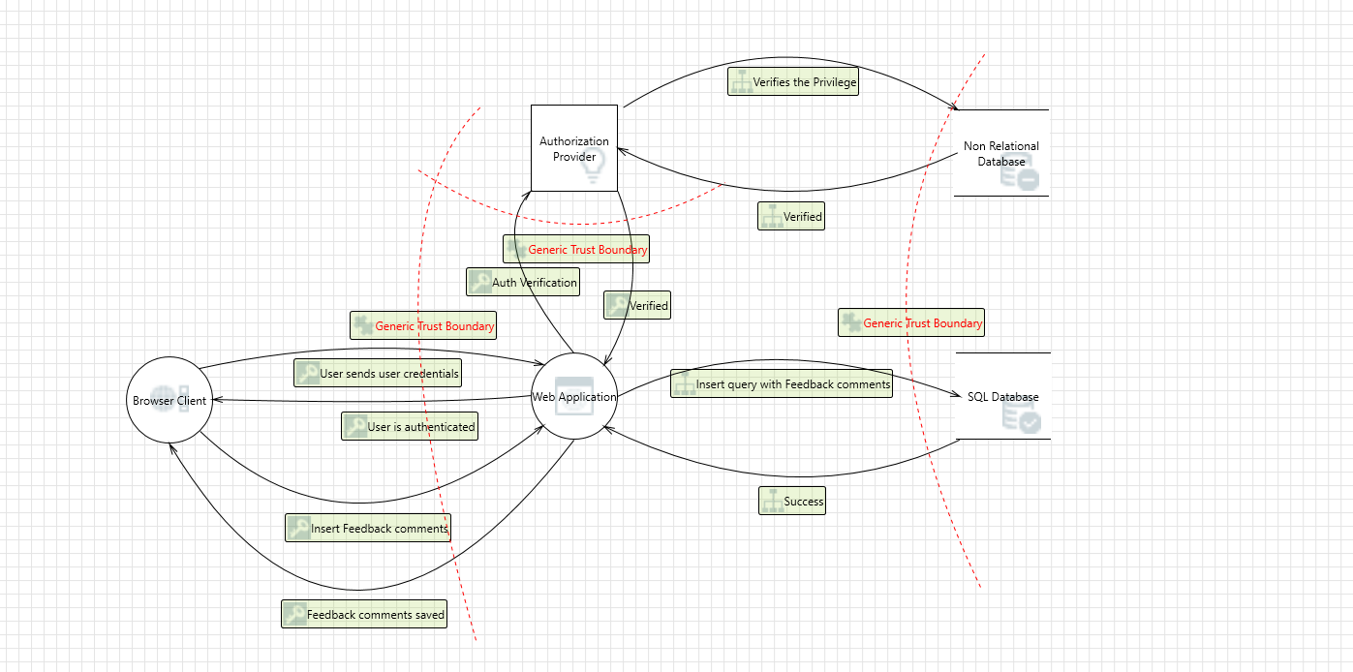
Flow Diagram of Feedback Sharing System

Slide 3
Cyber Kill Chain Framework: 3 Threats
Elevation of Privileges
DoS Attacks / DDoS Attacks
Spoofing

Slide 4
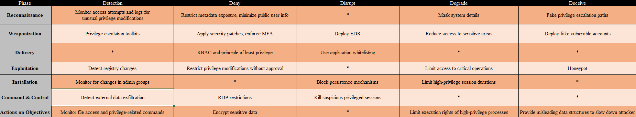
Threat 1: Elevation of Privileges

Slide 5
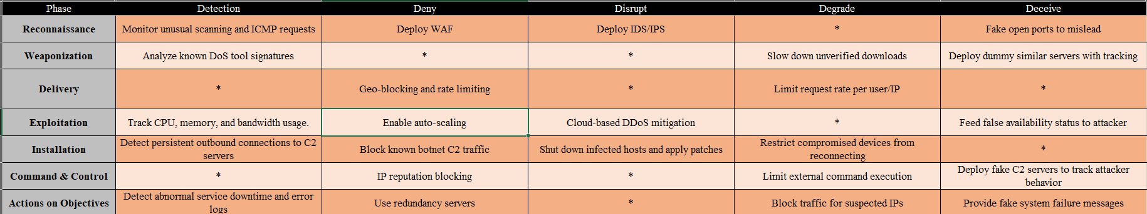
Threat 2: DoS Attacks / DDoS Attacks

Slide 6
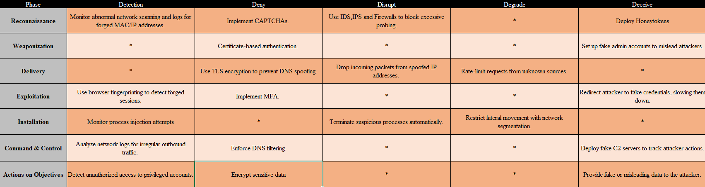
Threat 3: Spoofing

